Slide 1

Mini Capstone Project
Payel Mahata S-4616

Slide 2

Introduction
This is a project to perform data analysis on Maven Movie dataset using MySQL and MS Excel.

Slide 3
Agenda
Objectives
Process
Tasks
Summary
QnA

Slide 4

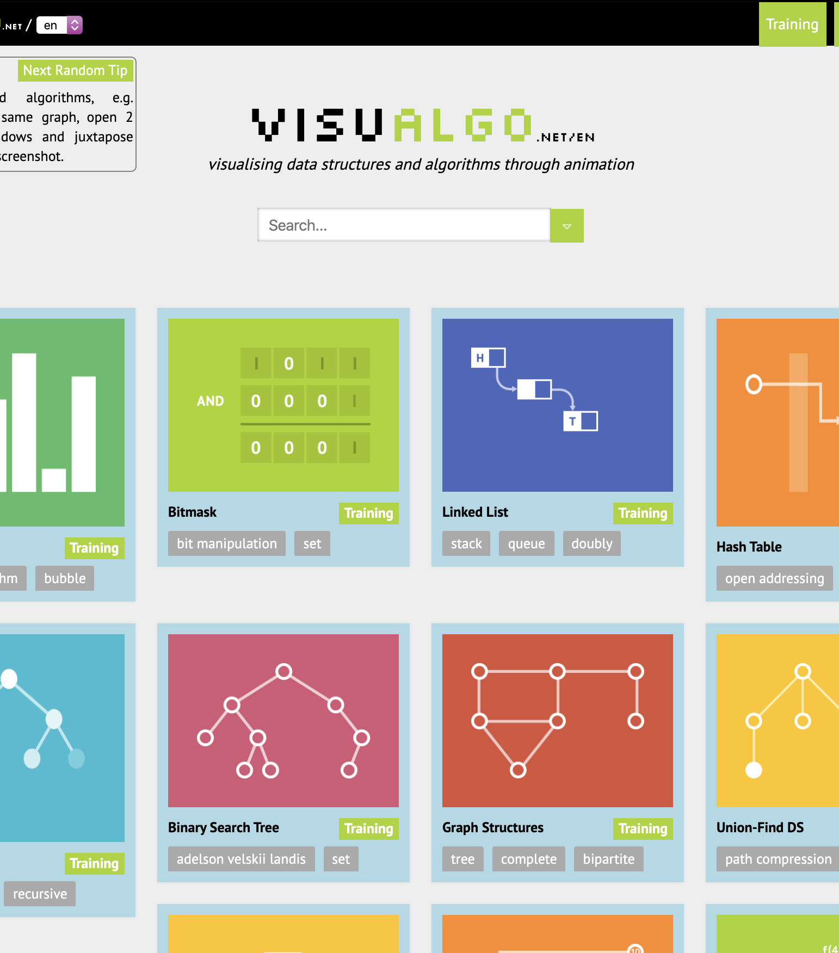
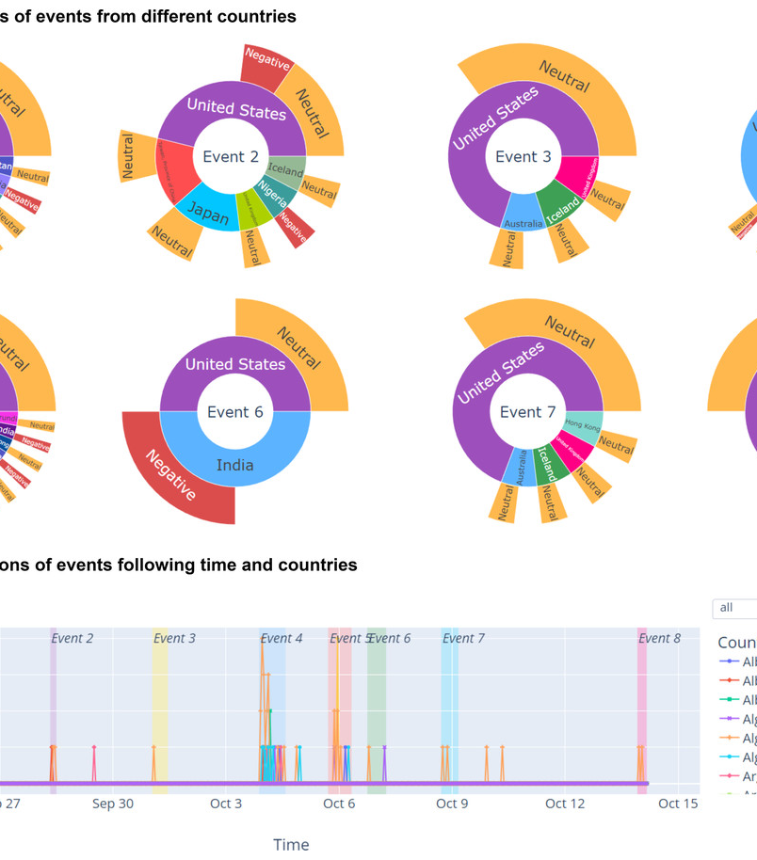

Process
Data Sourcing
Data Filtering
Data Visualization
Data Analysis

Slide 5



OBJECTIVES
Analyze Rental Trends
Analyze the monthly rental trends
Determine the peak rental hours in a day based on rental transactions
Determine Film Popularity
Identify the top 10 most rented films
Determine which film categories have the highest number of rentals
Assess Store Performance
Identify which store generates the highest rental revenue
Determine the distribution of rentals by staff members to assess performance

Slide 6
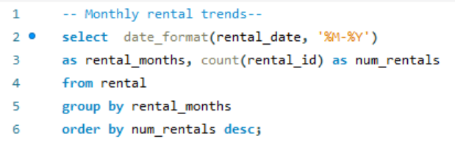
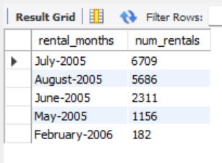
Analysis of Monthly Rental Trends
Insights:
Highest rental counts in July, 2005 and lowest in February, 2006 presented with line and column chart.
Rental activity starts from May, 2005 and gradually its increasing, reaches its peak in July, afterwards it starts decreasing
Recommendations:
Promote sales and offers to increase rental activity during September to January
Focus on inventory during peak sales month.

Slide 7
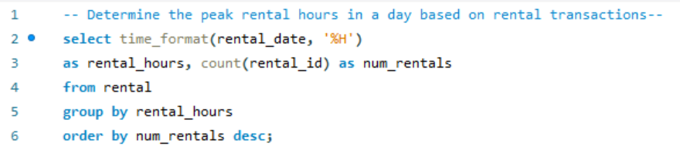
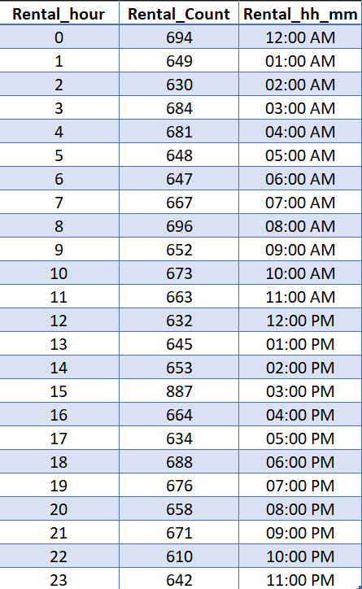
Analysis of Peak Rental Hours
Insights:
Peak rental hour happens around 3 p.m
Rental counts show uniform trend through out the rest of the day
Recommendations:
Optimize staffing and inventory around 3 p.m. to handle the peak demand efficiently
Introduce promotions or incentives during non-peak hours to boost rental activity evenly throughout the day

Slide 8
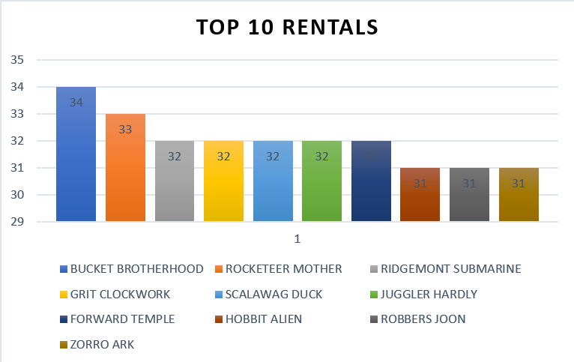
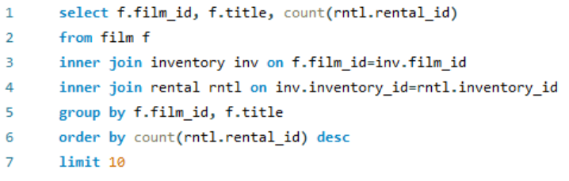
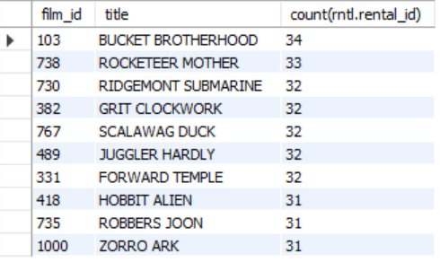
Analysis of Top Rented Films
Insights:
The most popular film is Bucket Brotherhood with 34 counts while Zorro Ark is least rented with 31 counts
Recommendations:
Promote Zorro Ark to increase its visibility, possibly through special offers, while maintaining the strong appeal of Bucket Brotherhood

Slide 9
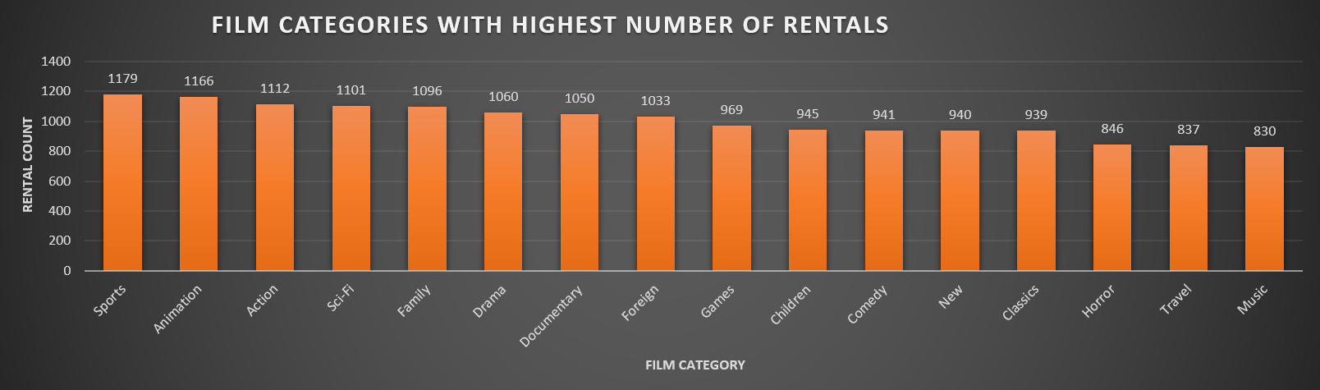
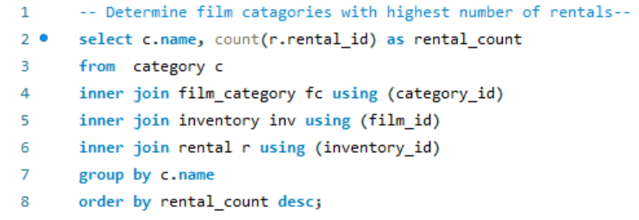
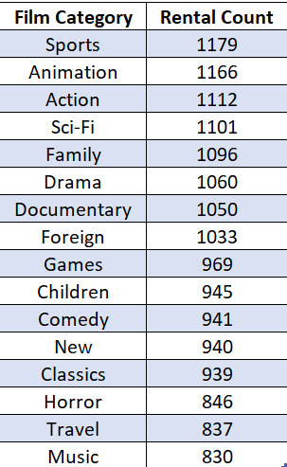
Analysis of Top Rental Film Category
Insights:
The Sports film category leads with the highest number of rentals
The Music category is the lowest, although the difference of the rental counts are marginal for other film categories
Recommendations:
Increase advertisements and promotional activities for the film which have rental counts below 1000, while continuing to leverage the popularity of the sports category.

Slide 10
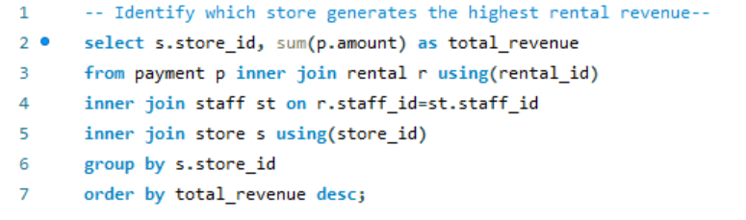

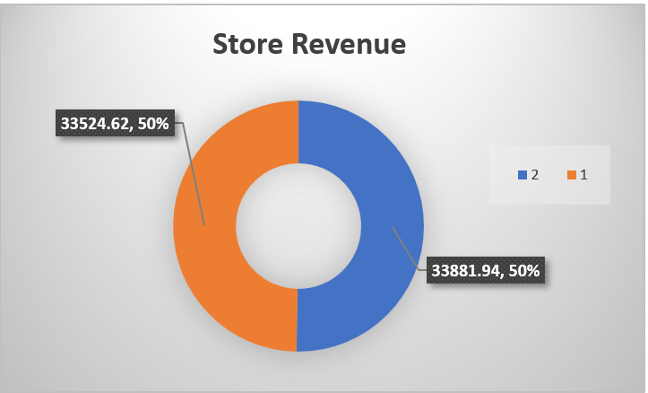
Analysis of Highest Store Revenue
Insights:
Store 2 generates slightly more revenue than Store 1, though the difference is not very significant.
Recommendations:
Focus on maintaining Store 2’s lead by optimizing operations
Identifying growth opportunities for Store 1 to close the revenue gap using targeted promotions or product diversification for Store 1

Slide 11
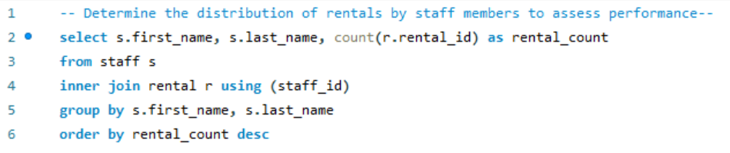
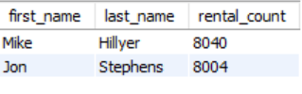
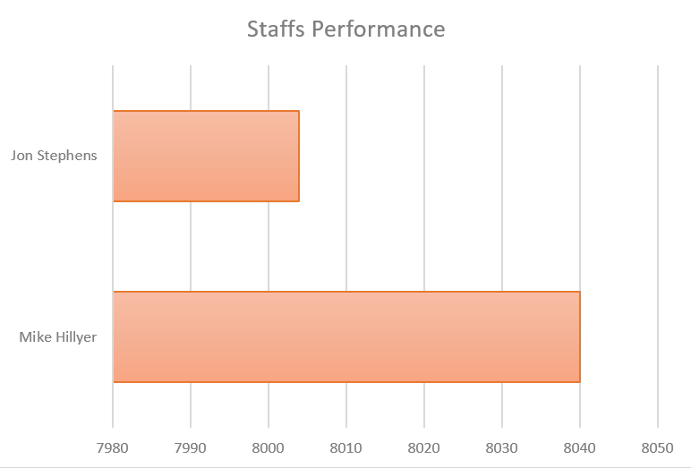
Analysis of Staffs Performance
Insights:
Mike Hillyer is the best performer with 8040 rental counts
Second is Jon Stephens with 8004 rental counts
Recommendations:
Acknowledge and motivate Mike to sustain his strong performance
Provide Jon with necessary training to help enhance his skills and improve his results

Slide 12
Summary
With the use of SQL to filter data and Excel to visualize trends, we gained valuable insights into the various performance metrics of the Maven movie dataset. With such knowledge we were able to identify areas of improvements that could help the business grow stronger.

Slide 13




Thank you

